Slide 1
Gencyber Grizzly Summer Institute
Day 2.3 Codes and Ciphers

Slide 2

Can we add letters?
a
a
What Could this possibly Equal?

Slide 3
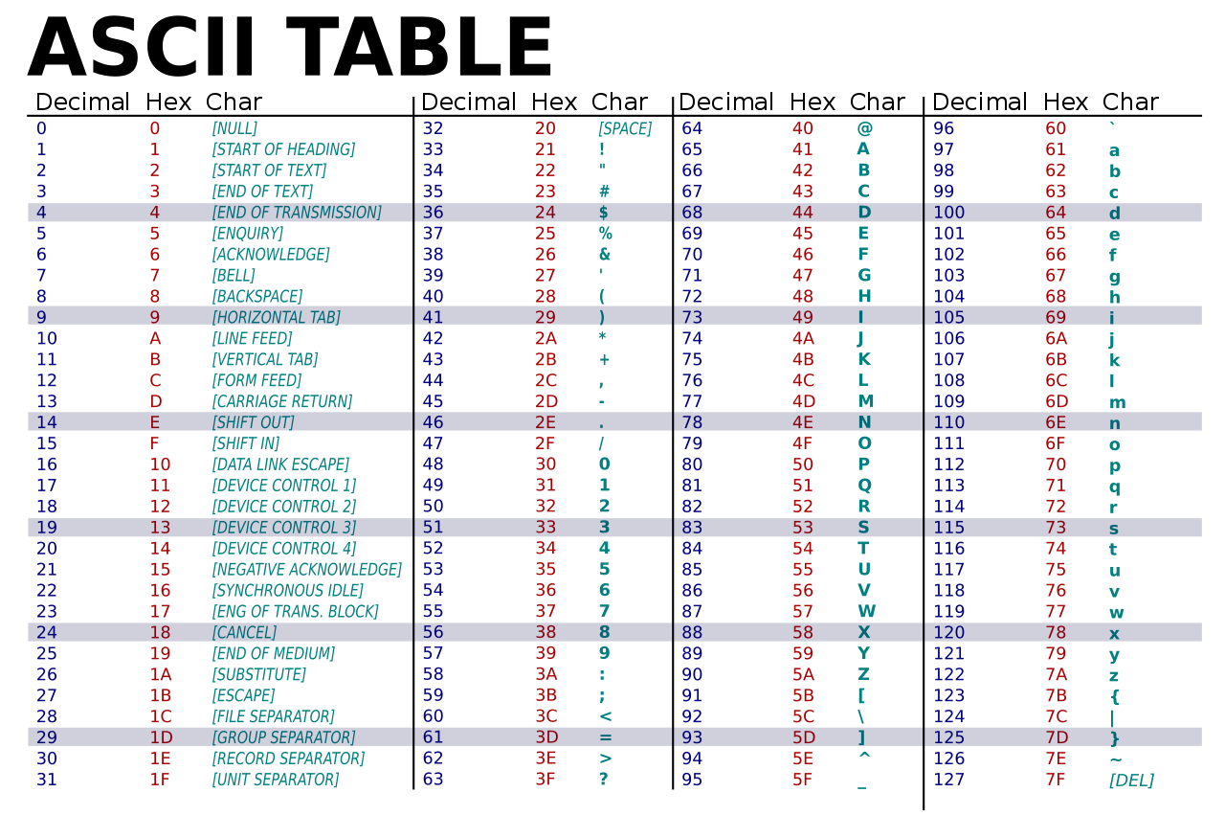
Computers naturally use numbers to represent alphabets.

Slide 4
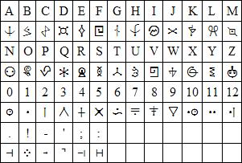
Symbol Cipher Alphabet
A is equal to this symbol and vice-versa.
Letter
Symbol
How could you map the Alphabet to numbers instead of symbols?

Slide 5
Symbol Cipher Alphabet
Note: Starts from zero. Why?
A | B | C | D | E | F | G | H | I | J
0 | 1 | 2 | 3 | 4 | 5 | 6 | 7 | 8 | 9
K | L | M | N | O | P | Q | R | S | T
10 | 11 | 12 | 13 | 14 | 15 | 16 | 17 | 18 | 19
U | V | W | X | Y | Z
20 | 21 | 22 | 23 | 24 | 25
A decimated alphabet (an alphabet converted to numbers).
Note: Ends at 25 instead of 26. Why?

Slide 6
What does this equal, then?
a
a

Slide 7
What does this equal, then?
a
a
0
a
0
0
With a mapping of letters to numbers we can perform arithmetic with letters!

Slide 8
Where do these line up?
a
1
b
1
0
1
b
1
0
a
1
0
A | B | C | D | E | F | G | H | I | J
0 | 1 | 2 | 3 | 4 | 5 | 6 | 7 | 8 | 9
K | L | M | N | O | P | Q | R | S | T
10 | 11 | 12 | 13 | 14 | 15 | 16 | 17 | 18 | 19
U | V | W | X | Y | Z
20 | 21 | 22 | 23 | 24 | 25

Slide 9
Where do these line up?
z
1
26
25
a
1
-1
0
A | B | C | D | E | F | G | H | I | J
0 | 1 | 2 | 3 | 4 | 5 | 6 | 7 | 8 | 9
K | L | M | N | O | P | Q | R | S | T
10 | 11 | 12 | 13 | 14 | 15 | 16 | 17 | 18 | 19
U | V | W | X | Y | Z
20 | 21 | 22 | 23 | 24 | 25

Slide 10
Where do these line up?
z
1
26
25
a
1
-1
0
-1 is less than 0, there is no mapping.
A | B | C | D | E | F | G | H | I | J
0 | 1 | 2 | 3 | 4 | 5 | 6 | 7 | 8 | 9
K | L | M | N | O | P | Q | R | S | T
10 | 11 | 12 | 13 | 14 | 15 | 16 | 17 | 18 | 19
U | V | W | X | Y | Z
20 | 21 | 22 | 23 | 24 | 25
26 is bigger than our mapping

Slide 11
Remainders
z
1
26
25
Value of Z + 1.
1
26
26
Letters in alphabet.
What is the Remainder?

Slide 12
Remainders
z
1
26
25
26
26
1
Remainder is 0! What is the 0 in our mapping?

Slide 13
Modulus Math
(
z
1
)
0
a
Mod 26
25
(
a
1
)
25
z
Mod 26
0
A | B | C | D | E | F | G | H | I | J
0 | 1 | 2 | 3 | 4 | 5 | 6 | 7 | 8 | 9
K | L | M | N | O | P | Q | R | S | T
10 | 11 | 12 | 13 | 14 | 15 | 16 | 17 | 18 | 19
U | V | W | X | Y | Z
20 | 21 | 22 | 23 | 24 | 25

Slide 14
Modulus Wheel
y
z
a
b
x
c
w
26
1
2
d
25
3
24
4
e
v
23
5
6
f
u
22
7
g
21
t
8
20
h
9
s
19
i
18
10
r
11
j
17
12
q
16
15
13
14
k
p
l
o
n
m

Slide 15
The Caesar Cipher
What happens if we add 3 to each letter?
hello world!
A | B | C | D | E | F | G | H | I | J
0 | 1 | 2 | 3 | 4 | 5 | 6 | 7 | 8 | 9
K | L | M | N | O | P | Q | R | S | T
10 | 11 | 12 | 13 | 14 | 15 | 16 | 17 | 18 | 19
U | V | W | X | Y | Z
20 | 21 | 22 | 23 | 24 | 25

Slide 16
The Caesar Cipher
Add 3 to each letter!
hello world!
khoor zruog!
A | B | C | D | E | F | G | H | I | J
0 | 1 | 2 | 3 | 4 | 5 | 6 | 7 | 8 | 9
K | L | M | N | O | P | Q | R | S | T
10 | 11 | 12 | 13 | 14 | 15 | 16 | 17 | 18 | 19
U | V | W | X | Y | Z
20 | 21 | 22 | 23 | 24 | 25

Slide 17
The Caesar Cipher
Subtract 3 from each letter!
khoor zruog!
hello world!
A | B | C | D | E | F | G | H | I | J
0 | 1 | 2 | 3 | 4 | 5 | 6 | 7 | 8 | 9
K | L | M | N | O | P | Q | R | S | T
10 | 11 | 12 | 13 | 14 | 15 | 16 | 17 | 18 | 19
U | V | W | X | Y | Z
20 | 21 | 22 | 23 | 24 | 25

Slide 18
Recap
Any letter can be mapped to a number
This is an encoding
Letters mapped to numbers can have mathematical operations performed on them.
The Caesar Cipher is one such operation.
It hides the original message using a very simple mathematical operation.

